Slide 1

PORTFOLIOPROJECT
ONLINE QUIZ PLATFORM
Author : DARHMAOUI
AAMR

Slide 2
DESCRIPTION OF THE PROJECT
Online Quiz Platform: Revolutionizing Learning and Training"
"Engage, Analyze, and Succeed with Technology"
The Online Quiz Platform is a comprehensive solution designed to modernize the way quizzes, tests, and assessments are conducted. By combining intuitive interfaces, gamified elements, and data-driven analytics, the platform caters to the needs of educators, corporate trainers, and learners.

Slide 3
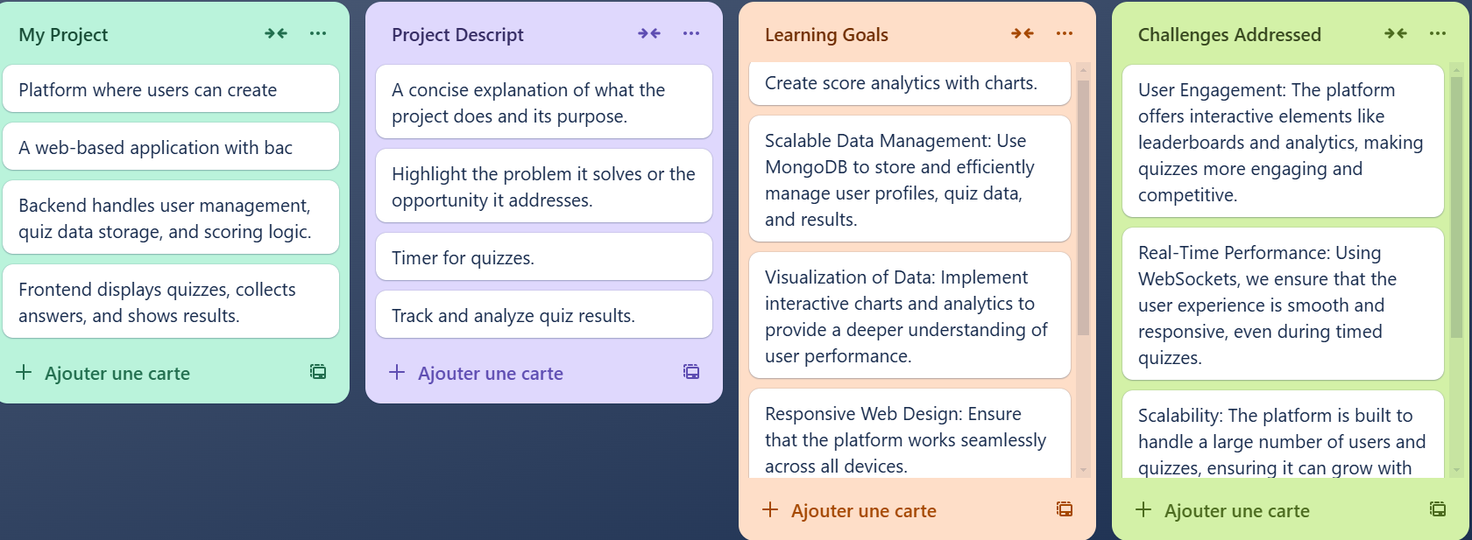
PROJECT STRUCTURE

Slide 4
LEARNING OBJECTIVES
Modernize Learning:Replace traditional quizzes with an interactive, accessible digital platform.
Engage Users:Introduce gamified elements such as leaderboards and badges to boost motivation.
Provide Insights:Deliver real-time analytics to help admins and users make data-driven decisions.
Ensure Accessibility:Build a mobile-first design for seamless use across devices.
Scale and Secure:Create a scalable architecture capable of supporting a growing user base, while maintaining robust security.

Slide 5
CORE FEATURES
User Authentication: Admin: Manage quizzes and view analytics./ User: Participate in quizzes and view progress.
Secure login and signup using JWT (JSON Web Tokens).
Quiz Creation (Admin): Multiple-choice questions. Time limits and difficulty levels. Customizable answer options.
Admins can create quizzes.
Quiz Participation (User): Take quizzes and receive instant feedback on answers. Track their progress after completing a quiz.
Gamification: Leaderboards display user rankings and scores to foster healthy competition. Badges and achievements for milestones like highest scores or consistent participation.
Analytics:
For Admins: Visualize quiz attempts, average scores, and success rates using advanced charts.
For Users:Track personal performance over time with user-specific analytics.
Responsive Design: Mobile-first approach ensures accessibility on smartphones, tablets, and desktops.

Slide 6
Target Audience
Educators:
Engage students with interactive quizzes.
Monitor student performance and identify knowledge gaps.
Corporate Trainers:
Train employees efficiently with tailored quizzes.
Measure knowledge retention and learning outcomes.
Learners:
Self-assess understanding in an engaging, gamified environment.
Compete on leaderboards to stay motivated.

Slide 7
TECHNOLOGIES USED
Frontend:
React.js: For building a dynamic, user-friendly interface.
HTML/ CSS: To ensure a responsive and visually appealing design.
Backend:
Node.js : For API development and JAVASCRIPT run-time.
MongoDB: A NoSQL database for managing users, quizzes, and results.
Analytics:
D3.js: For creating interactive data visualizations.
Security:
JWT for secure authentication.

Slide 8
Challenges in Creating the Online Quiz Platform
Technical Challenges
Scalability: Ensuring the system handles high user traffic without performance issues.
Real-Time Feedback: Providing instant and accurate feedback during quizzes.
Advanced Analytics: Building efficient, visually appealing data dashboards
User Experience Challenges
Gamification Balance: Designing leaderboards and rewards to motivate without overwhelming.
Admin Interface: Creating an intuitive and easy-to-use quiz management dashboard.
Accessibility: Ensuring the platform is inclusive for users with disabilities.
Operational Challenges
Content Moderation: Preventing misuse of the platform (e.g., inappropriate quizzes).
User Adoption: Encouraging users to transition from traditional methods.
Solutions:
Use efficient technologies like MongoDB, React, and D3.js.
Implement gamification thoughtfully with diverse rewards.
This ensures scalability, engagement, and inclusivity for all users.

Slide 9
WORK SCHEDULE
Phase 1: Planning
Define objectives, target users, and features. Create wireframes and technical architecture.
Deliverables: Project documentation, UI wireframes.
Phase 2: Backend Development
Setup project, implement user authentication, design database. Develop quiz APIs (CRUD, submissions, leaderboards). Create analytics APIs, implement performance tracking, write tests.
Deliverables: Fully functional backend with APIs and tests.
Phase 3: Frontend Development
Build user authentication (login/signup), navigation bar. Develop dashboards for admin and user roles, leaderboards. Add analytics visualizations (D3.js), ensure responsive design.
Deliverables: Responsive UI with all features integrated.
Phase 4: Testing & Deployment
Conduct end-to-end testing, fix bugs. Deploy backend and frontend
Deliverables: Fully deployed, tested application.
Phase 5: Feedback and Refinement
Collect feedback from users and make improvements.
Deliverables: Finalized application ready for users.

Slide 10
CONCLUSION
The Online Quiz Platform represents a bold step forward in modernizing education and corporate training. By combining ease of use, gamification, and actionable insights, it transforms traditional learning into an interactive and measurable experience. Built on a robust and scalable technology stack, the platform ensures secure, seamless, and enjoyable engagement for all users.
With its ability to empower educators, trainers, and learners alike, the Online Quiz Platform is not just a tool . it’s a bridge to the future of learning. Whether you're looking to enhance classroom education, optimize corporate training, or provide self-paced learning opportunities, this platform delivers results.
Now is the time to revolutionize learning experiences. Let’s create a world where knowledge is not just acquired but enjoyed. Partner with us, and together, we can make learning smarter, engaging, and more impactful than ever before.

